Slide 1
Big Game Census Analytics
Ghanshyam Saini

Slide 2
Problem Statement:
This Big Game Census data visualization takes a fun look at where Super Bowl 52
players come from, the related population figures, and opens up pathways (via
embedded links) to additional census data points.
The dataset came about when two hapless data nerds had their teams eliminated fromthe playoffs, thus turning to data to try to find more rooting interests for Super Bowl 52.
The rosters for both, competing teams are included, with the corresponding roster
information and birthplace and state population information. The developers utilized census data pulled from census.gov, and roster information from Yahoo Sports, and designed the data visualization within the Tableau platform.

Slide 3
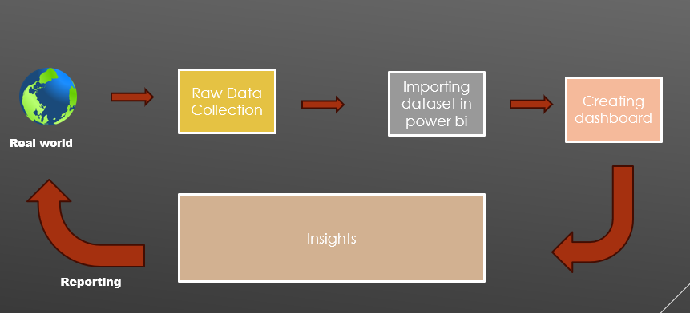
DATABASE ARCHITECHTURE

Slide 4
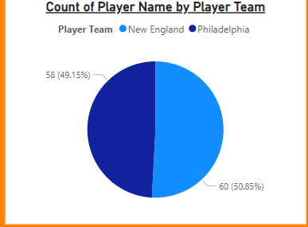
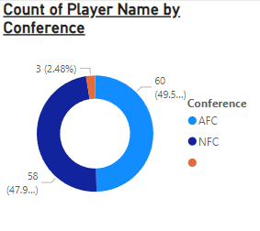
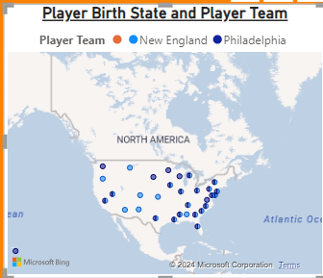
Insights:
There are 60 players in New England and 58 players in Philadelphia.
60 from AFC AND 58 players from nfc and 3 from others
Players are more from Texas and california

Slide 5
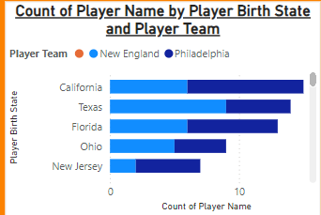
Players from state
More players from Philadelphia are from California.
More players from New England are from Texas.
Overall more players are from California and texas

Slide 6
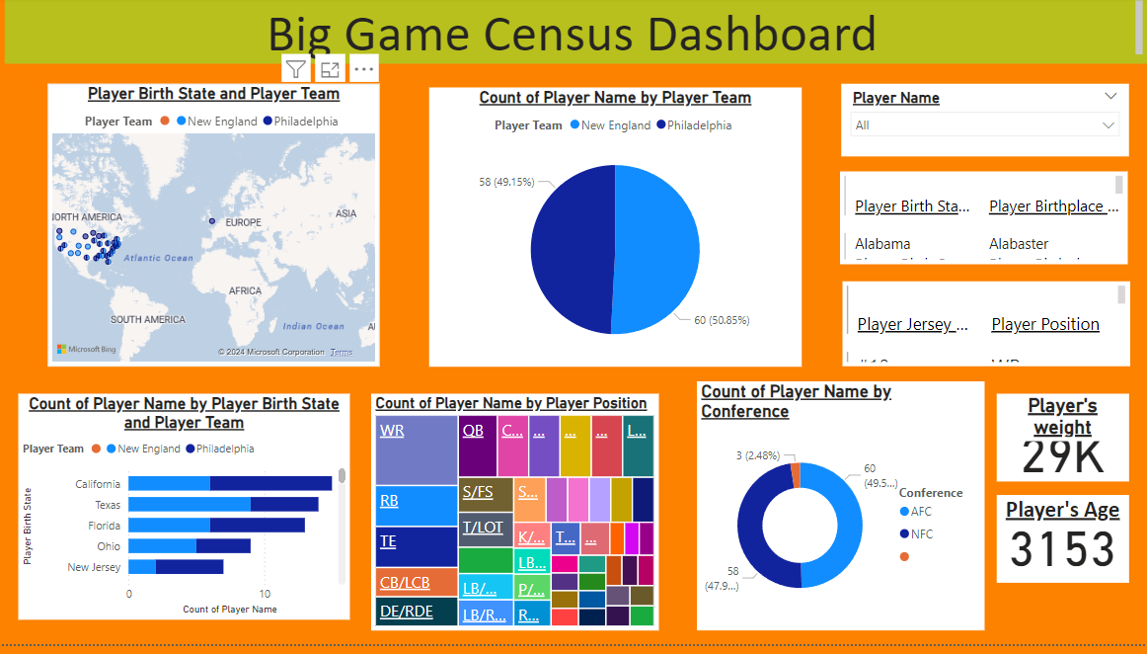

Slide 7
KPI’S
Players name , age , weight, team , conference and birthplace.
Count of players by State
Total players in each team
Total players in each conference

Slide 8
Thank You

